Slide 1
Origin of Petroleum and natural gas
Name : naruboyna jaya avinash yadav
Roll no : 19154017
Mining engineering ( 3rd sem)
To : dr. C.S.SINGH

Slide 2
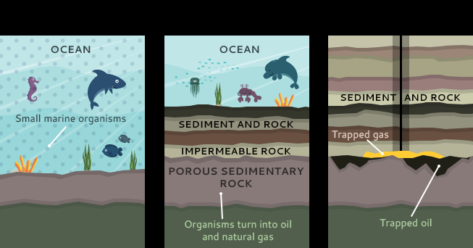
General origin of petrol and natural gas
Millions of years ago , the earth populated with animals and plants near the water bodies. As plants and animals died they all go to the bottom of these water bodies. So that the mud and sand cover the organic material. So that organic material continued build up so that the rock will cut off due to high pressure and low oxygen the decomposition slows so that the thickness will build over and over. And hence the formation of petrol and natural gas.

Slide 3
petroleum
Petroleum is a Latin word i.e.., (Petra = rock, +oleum = oil)it is different from the vegetable oil. But by the research traced that origin to the lipids of planktonic plants and animals which live in brackish water as algae's.
In brackish water it would decompose all organic matter . Planktonic plants and animals sink to the bottom and incorporated into clay sediments which after becomes sedimentary rock(shale rock).
Under high pressure and temperature oil of the clay shales are got out into porous rock. In that rock oil can travel , until it reaches an impervious barrier i.e.., salt dome.

Slide 4
Natural gas
Natural gas it is a naturally occurring hydrocarbon gas mixture that is primarily consisting of methane gas. And some small percentage of other gases.
Natural gas is found in deeper rocks or associated with other hydrocarbons . Is formed when plants and animals are trapped beneath the sedimentary layers of the earth.
Natural gas is nothing but (-CH4-) links.
Natural gas was accidentally discovered in ancient china . Found from the drilling of brines.
To transport the gas they will convert it inti liquid natural gas (LNG).

Slide 5
Inorganic origin of petrol
This is favoured at one time by Russians
States that hydrogen and carbon come together under high temperature and pressure in the far below the surface of earth and the oil and gas formed in this the occurrence of chemical reactions have occurred.
W.K.T oil and gas are seeped from the porous rock in the bottom to deposit the natural underground taps so in this way the petroleum will be formed there are also some type of theories regarding to this inorganic origin:
Metal carbide theory
Volcanic theory
Earthquake theory
Serpentinization theory
Geographical location
Stability with depth

Slide 6
Different types of theories (inorganic origin)
METAL CARBIDE THEORY:
This theory states that deposition of petroleum is controlled by tectonic activities that occurred during transition of sedimentary rock . Metal carbides deep they react with water to form acetylene which forms up to higher carbon.
VOLCANIC THEORY:
by out gassing the mantle via volcanic activity .
EARTHQUAKE THEORY:
By outgassing deep earth’s mantel via tectonic activities such as faults.
SERPENTIZATION THEORY:
this theory states that hydrocarbon is a by product which is from the metamorphic rocks transformation of green dark olivine mineral it is in earths mantle.
GEOGRAPHICAL LOCATION:
Hydrocarbons produced in the belts of tectonic planes.
STABILITY WITH DEPTH:
Corresponding to the organic theory supporters they said petrol is a fossil which cannot be found below 16000 feet but now a days we are drilling nearly 30000feet where no fossil remains according to organic theory.

Slide 7
Inorganic origin of natural gas
Natural gas methane may have been prepared by inorganic processes but the original source of earth carbon was the cosmic form from which the earth formed.
Carbon could have been supplied in comparatively higher concentration of hydrocarbons that is found in carbonaceous chondrite type of meteorites . By continuous outgassing some of abiogenic gas deposits without passing through organic phase.
In that case it is likely to diffuse that gas and give the formation of methane.

Slide 8
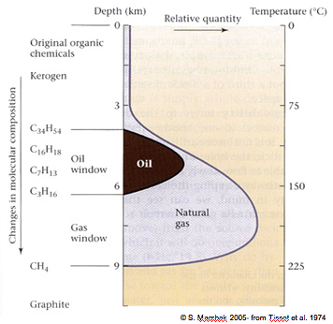
ORGANIC ORIGIN OF PETROLEUM
This favoured at one time in UK and USA
This origin is mostly accepted . The formation of oil and gas is from the prehistoric plants and animals that are transformed coal and oil and gases.
These resins are settled at bottom of the waterbodies and buried over the ocean or sea floor and form into sediments . And after the million years thick layers of sediments covert due to the weight above them increase of pressure and temperature and lack of oxygen they convert sediments of mud sand slit to rock and organic matter to kerogen .
Kerogen tend into burial and heating it converts into petrol and natural gas by cracking.

Slide 9
Organic origin of natural gas
Natural gas is more wide spread than oil , it is derived from the both land plants and aquatic organic matter and is generated above.
Many source rocks of significant gas associated with occurrence of coal is from the carboniferous and early times. Roughly 300 million years ago.
During the immature formation of petroleum formation marsh gas is produced as a result of decay of organic material by action of anaerobic microbes these cannot tolerate the small traces of oxygen by dissolving in the high concentration of sulphate . In this way biogenic gas generated
The mature stage of petroleum about 750 to 5000 mts, includes the full range of hydrocarbons that are produced within the oil window. The thermal methane gas of significant amount are generated along with oil. So that wet gas formed.
In postmature stage below 5000mts oil is no longer stable in that state of high temperature and pressure so the cracking of oil that is existing of liquid hydrocarbons so the thermal gas is produced. In that state longer chains of hydrocarbons destroyed rapidly in deep basins of thick layers the deep gas production occur.

Slide 10
Origin of petroleum in india
Petroleum is India next biggest source after coal . It helps to supply heat , lighting power , lubricating machines , manufacturing industries and synthetic textiles , fertilizers and for chemical industries such as nodal industries.
India's most petroleum is found in anticline and fault traps and in tertiary rock formation . It occurs in folding regions anticlines or domes. That is trapped under unfold crust.
The first oil deposits in the country were discovered near the town of Digboi in the state of Assam in 1889.
India is heavily dependent on crude oil and LNG imports 82.8% dependence for crude oil.
India is the third biggest oil consumer in world . In India accounted for 0.92% of world oil. crude petroleum had a CAGR of 0.63% in 2017 to 2018 . In India ONGC is developing block in Krishna Godavari basin. Leading to peak oil production from that basin.
India has deployed 159 rings and 545 drilled this way we stand globally fifth in 2017 to 2018 but the production is not equal to the wells drilled.
Companies that provide petroleum is Reliance, Cairn energy, Oil India limited, Indian oil corporation limited, ONGC, HPCL, Premier oil etc..,

Slide 11
Origin of natural gas in India
Natural gas industry in India started in 1960 . In the gas fields of assam and Gujarat . Natural gas gained of large reserves of natural gas in south basin fields by ONGC 1970 .
Natural gas in India generally found in fault traps and anticlinal traps.
India largest gas reserve are found in Bombay high basin and Gujarat, Off shore reserve at Krishna Godavari basin,
India has only limited reserves of natural gas through further discoveries are made from recent explorations. In the process of extraction of natural gas involves making large cavities in the ground. So it require high treatment plans and pipelines.
Some companies that extract natural gas ONGC, GSPC, Niko resources, BG India, RIL .

Slide 12
Thank you

